Slide 1

FINAL PROJECT REVIEW
Explainable Loan Prediction Using Financial Behaviour Consistency Engine (FBCE)
B.Tech CSE – Artificial Intelligence and Machine Learning | Final Project Report, October 2026
PRESENTED BY
PROJECT GUIDE
A Guhan (23619148)
S Prem Kumar (23619129)
Dr. N. Meenakshi, M.Tech., Ph.D.
Department of Artificial Intelligence and Machine Learning | School of Engineering
Vels Institute of Science, Technology and Advanced Studies (VISTAS), Chennai – 600 117
Notes:
Title slide. Project: Explainable Loan Prediction Using the Financial Behaviour Consistency Engine (FBCE). Students: A Guhan (23619148), S Prem Kumar (23619129). Guide: Dr. N. Meenakshi, M.Tech., Ph.D.

Slide 2
Introduction, Problem and Research Gap
PROBLEM
OBJECTIVES
A label with no reason; auditors and regulators expect explainable credit decisions.
Income, loan, term and credit history are never checked against each other.
Labels record lender approval, not repayment, so past bias carries over.
Probabilities near 0.5 are easily read as firm decisions.
1
Build a loan-prediction model on a public dataset.
2
Compare four classifiers under one pipeline.
3
Develop FBCE: five components, score, level, warnings.
4
Explain predictions with SHAP contributions.
5
Integrate everything in a Streamlit dashboard.
6
Support transparent human review; document limits.
RELATED WORK
RESEARCH GAP
No source reviewed measures an application’s own consistency. FBCE keeps that score apart from the classifier output.
Logistic regression stays competitive on credit data [1], [16].
SHAP is routine in credit models [5]; interpretable models suit high stakes [11].
The closest hybrid [6] merges rule penalties into the model score.
Notes:
Classifiers return labels without reasons and never check whether application details agree with each other. FBCE adds a consistency view and SHAP adds an explanation view. Reference numbers follow the project report; the gap statement is limited to the sources reviewed.

Slide 3
System Workflow
1
Applicant Input
2
ML Prediction
3
FBCE Analysis
4
SHAP Explanation
5
Dashboard Output
Eleven attributes: incomes, loan, term, credit history, employment, gender, marital status, dependents, education, area.
Imputation, one-hot encoding, scaling. Four classifiers benchmarked; the saved pipeline returns a label and probability.
Works on raw values. Five component scores, mean 0–100, level and contradiction warnings.
Linear explainer for logistic regression, tree explainer for tree models. Ten largest signed contributions.
Streamlit panels side by side: prediction, FBCE, warnings, SHAP. Notices state it is not a banking decision.
Two independent paths: FBCE reads the raw application in parallel with the ML path. Signals are shown side by side and never merged into one number.
Notes:
The five stages of the delivered prototype. The ML path and the FBCE path read the same inputs but never each other's outputs, so a disagreement between them stays visible to the reviewer.

Slide 4
Dataset and Preprocessing
614
68.7%
7 of 12
20
applications
approved (422 Y, 192 N)
attributes with missing values
model inputs after encoding
PREPROCESSING IN ONE SCIKIT-LEARN PIPELINE
Target mapped Y/N to 1/0; Loan_ID dropped
Numeric: median imputation, then standardisation
Categorical: most-frequent imputation, one-hot encoding
Five numeric plus fifteen one-hot columns
Stratified 80/20 split, seed 42
Data note: no debt or employment-duration column exists, so FBCE uses the requested loan as a debt proxy and Self_Employed as an employment proxy.
Credit history almost determines the label; self-employment barely matters. Earlier exploratory analysis of the 614-record file.
Notes:
Public Loan Prediction dataset in the Kaggle format, 614 applications. Credit history almost determines the label. The dataset has no debt or employment-duration column, so FBCE uses proxies.

Slide 5
Classifier Benchmark: Logistic Regression vs XGBoost
Model | Acc. % | Prec. % | Rec. % | Spec. % | F1 % | AUC
Logistic Regression (selected) | 80.30 | 79.01 | 97.16 | 43.28 | 87.14 | 0.751
Random Forest | 79.15 | 78.84 | 95.26 | 43.81 | 86.26 | 0.749
XGBoost | 78.18 | 79.53 | 91.94 | 47.98 | 85.25 | 0.752
LightGBM | 75.40 | 79.00 | 87.43 | 48.97 | 82.97 | 0.740
LOGISTIC REGRESSION VS XGBOOST
Logistic regression ahead
Accuracy 80.30 vs 78.18
Recall 97.16 vs 91.94
F1 87.14 vs 85.25
XGBoost ahead
Specificity 47.98 vs 43.28
Precision 79.53 vs 79.01
AUC 0.752 vs 0.751
Fold SDs of 1.1–5.3 points exceed most gaps, so the models are close. Logistic regression was chosen for F1 and readable SHAP values.
Experiment A: stratified 5-fold cross-validation, fold means, 614 records
A: 5-fold cross-validation
Source of the table above. Reported from the earlier phase; the script is not delivered, so it is not reproduced.
B: single 80/20 split
Delivered train_model.py. No real-data output available. Synthetic check (160 test records, 12 approved): LR accuracy 0.625, F1 0.211; RF 0.919, F1 0.000. This shows the pipeline runs, not model quality. XGBoost and LightGBM not run.
Notes:
Experiment A (5-fold cross-validation, fold means, 614 records) is reported from the earlier evaluation phase; its script is not delivered. Experiment B is the single 80/20 split in the delivered train_model.py. The real-data output of Experiment B is not available, so A and B must not be compared.

Slide 6
Financial Behaviour Consistency Engine
1
Income consistency
100 × (1 − min((L / IT) / 10, 1))
CONSISTENCY LEVELS
High
80 or above
2
Debt consistency (loan as proxy)
100 × (1 − min((L / IT) / 8, 1))
Moderate
60 to below 80
Employment stability
75 salaried, 65 self-employed, 55 other
Low
40 to below 60
3
Very Low
Below 40
4
Credit consistency
90 if credit history ≥ 1, otherwise 30
CONTRADICTION WARNINGS
5
Repayment capacity
100 × (1 − min((EMI / IT) / 0.80, 1))
Total income is zero or unavailable
Loan above 8 times income
Credit history weak or unavailable
FBCE score = mean of the five component scores (equal weights)
Project-defined indicator, not a banking credit score.
IT = applicant + co-applicant income; L = loan amount; EMI = monthly instalment at an assumed 10% annual rate.
Notes:
FBCE works on raw application values. IT is total income, L the loan amount, EMI the monthly instalment at an assumed 10 percent annual rate. All constants are project-defined heuristics, not banking standards.

Slide 7
FBCE Worked Example and Validation
13
scoring test cases executed (T1–T13)
30
of 44 checks executed and passed
3
executed checks confirmed gaps
11
not run (libraries or data missing)
WHAT THE SENSITIVITY ANALYSIS EXPOSED
Units matter: the same applicant scores 90.89 with the loan in thousands and 45.94 in rupees.
Ratio components saturate near 100, so categorical components decide the score.
Dashboard scores range only from 19 to 93.
A weak credit history alone leaves the level High (92.93 to 80.93), so read warnings first.
FBCE score 90.89 High Consistency, no warnings
Notes:
Worked example from the report: income 5000, co-applicant 1500, loan 150 (thousands), term 360 months, good credit, self-employed. All FBCE values were reproduced by running the delivered fbce.py. Of 44 checks, 30 were executed and passed, 3 executed and confirmed documented gaps, 11 were not run because the libraries or real dataset were unavailable.

Slide 8
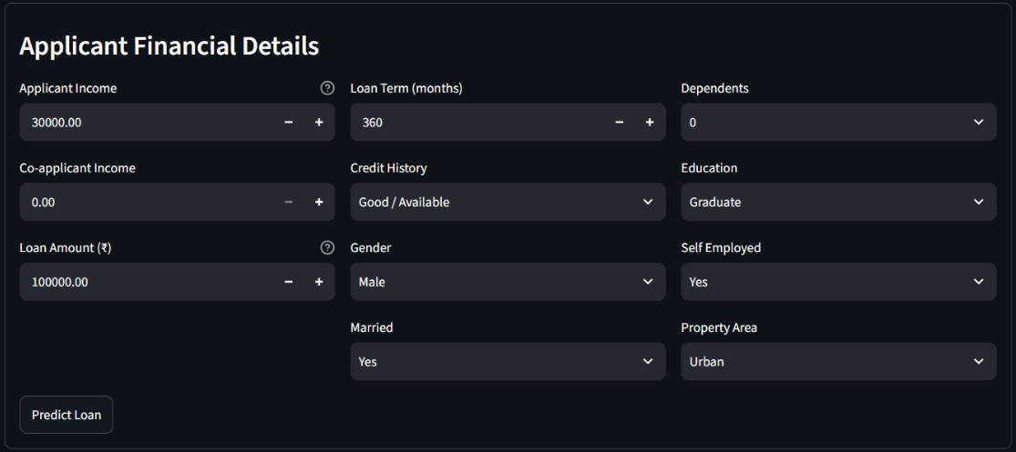
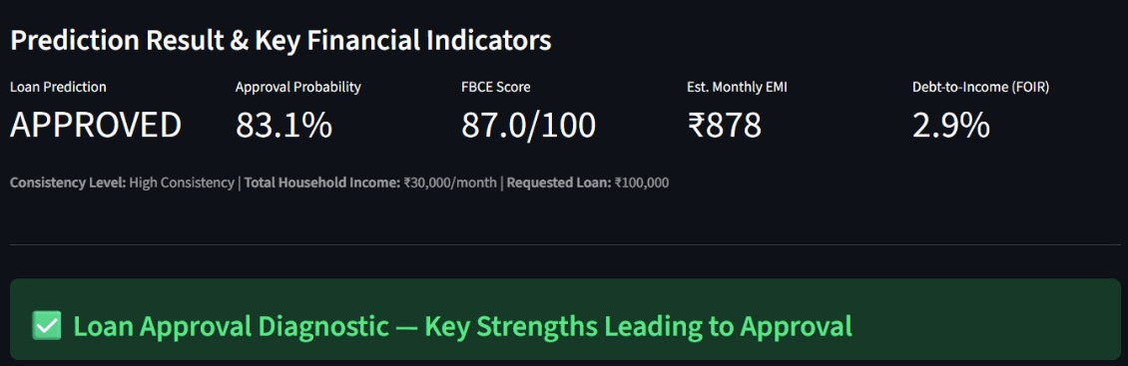
Dashboard: Applicant Inputs and Prediction
Prediction result and key indicators (screenshot)
Input form (screenshot)
INPUTS ENTERED
Applicant income 30,000; co-applicant 0; loan ₹100,000; term 360 months; good credit history. Male, married, graduate, self-employed, urban, no dependents.
OUTPUTS SHOWN
APPROVED with probability 83.1%; FBCE score 87.0/100, High Consistency; estimated EMI ₹878; debt-to-income (FOIR) 2.9%.
Notes:
Screenshots of the running Streamlit dashboard. Component values in this build differ from the fbce.py formulas shown in the report, so they are shown as that build's output, not as the report's formula results.

Slide 9
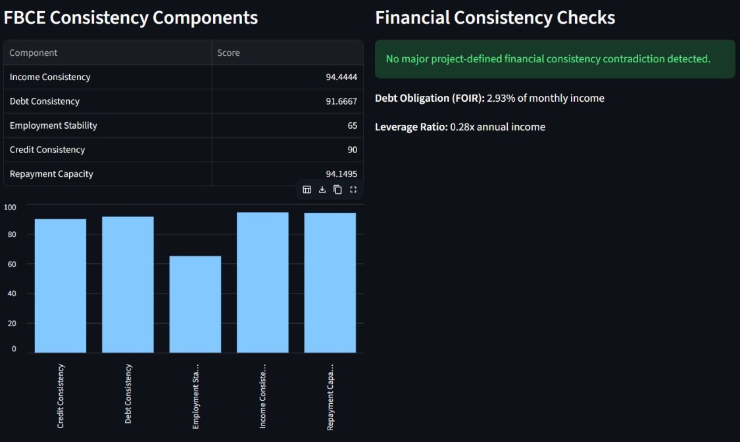
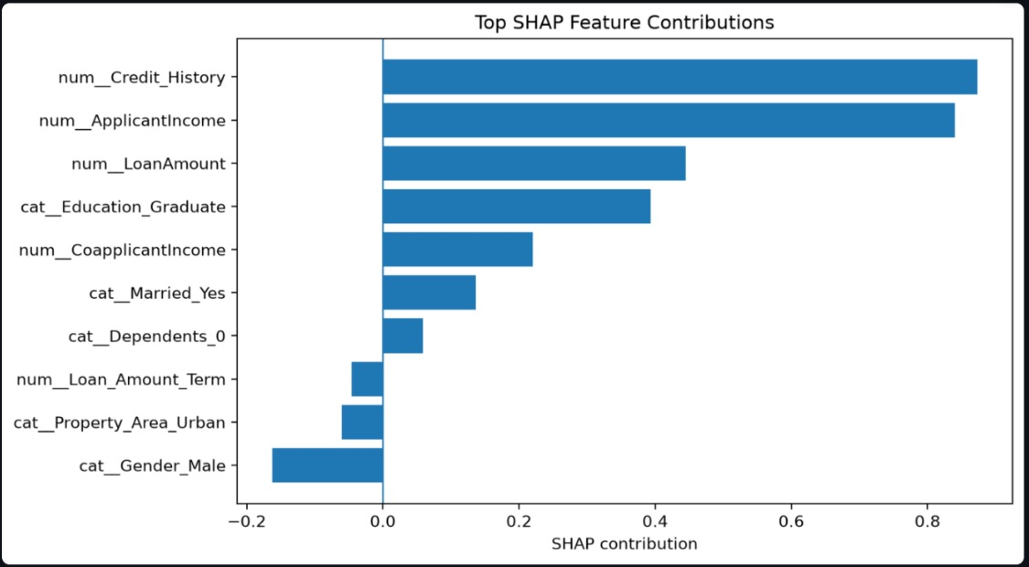
Dashboard: FBCE Consistency and SHAP Explanation
Top SHAP feature contributions (screenshot)
FBCE components and checks (screenshot)
FBCE READING
Components 94.44, 91.67, 65, 90 and 94.15 average to 87.0 (High). No contradiction; FOIR 2.93%; leverage 0.28x annual income.
SHAP READING
Credit history +0.873 and applicant income +0.8399 lead; male gender −0.1624 is the largest negative. Log-odds, not causal.
PROVENANCE NOTE
By the slide 6 formulas, income and debt would score 66.67 and 58.33 here, so this build scales differently. Training data is not stated.
Notes:
Left: FBCE component scores and consistency checks. Right: SHAP contributions as the dashboard displays them. Several contributions equal the values the report reproduced with its synthetic-data model (credit history 0.873, graduate 0.3933, male gender -0.1624), so the training data behind this run should be confirmed before treating it as a real-data result. The report's own case study (50.09% probability, FBCE 90.89) also came from the synthetic-data model.

Slide 10
Implementation and Illustrative Project Timeline
TECH STACK
Python
pandas / NumPy
scikit-learn
XGBoost / LightGBM
SHAP
Streamlit
ILLUSTRATIVE PROJECT TIMELINE
M1
M2
M3
M4
M5
M6
M7
M8
Literature Review
M1–M2
Dataset Collection
M2–M3
Preprocessing
M3–M4
Model Development
M4–M5
FBCE Development
M4–M6
SHAP Explainability
M5–M6
Dashboard Implementation
M6–M7
Testing / Evaluation
M7–M8
Documentation
M7–M8
Illustrative sequence and relative durations only. M1–M8 are relative months, not actual dates; no completion dates are claimed.
Notes:
The timeline is illustrative: it shows a sensible order and overlap of the nine phases. The uploaded files contain no phase start or end dates, so no actual dates or completion claims are made.

Slide 11
Limitations, Conclusion and Future Work
LIMITATIONS AND RESPONSIBLE USE
FUTURE WORK (PROPOSED)
614 approval-labelled records; no repayment outcomes.
FBCE thresholds are unvalidated; loan and income units are not converted, so scores saturate (range 19–93).
The report’s case study (50.09%) and earlier screenshots came from a synthetic-data model, not real-data results.
Probabilities are uncalibrated; no fairness metrics; Gender and Married remain features.
XGBoost, LightGBM, SHAP and Streamlit code were not executed when the report was prepared; no loan-officer test.
1
Convert units and validate inputs
2
Use data with liabilities, tenure and repayment outcomes
3
Calibrate probabilities (Platt or isotonic)
4
Fairness audit: remove protected attributes, add metrics
5
SHAP background from training data; show the intercept
6
Pin versions; add logging and access control
FBCE adds a transparent consistency and explanation layer beside the classifier, supporting human review rather than replacing it.
Logistic regression: 80.30% accuracy, 87.14% F1, AUC 0.751 (earlier 5-fold study). The FBCE score is a project-defined indicator, not a banking credit score.
Notes:
The project demonstrates a software design, not a validated lending model. Future work items are proposals only; none is implemented in the delivered prototype.

Slide 12
THANK YOU

